Slide 1

Employee Attrition prediction
Keiuntae smith
Bellevue university
Dsc680
Notes:
Good afternoon and welcome to my presentation on Employee Attrition prediction.

Slide 2
Table of contents
Introduction
Business Problem
Data
Explanatory Data Analysis
Methods and Analysis
Modeling
Evaluations
Future Uses/Additional Applications
Conclusion
Notes:
During this presentation I will be discussing the following:

Slide 3
INTRODUCTION
The topic of choice for my second project is to predict employee attrition through machine learning tactics using HR data created by IBM data scientists.
With attrition, the employer will not refill the position.
Ways Companies can prevent employee attrition include:
Encourage flexibility
Give incentives
Meet individual needs
Notes:
The topic of choice for my second project is to predict employee attrition through machine learning tactics using HR data created by IBM data scientists.
With attrition, the employer will not refill the position.
I have always been intrigued by what makes employees stay with jobs versus deciding to leave a job: personal motivation, professional motivation, challenges with the workforce, or even poor employee-to-job fitment.
Some of the current ways companies can prevent employee attrition include:
Encouraging flexibility
Giving incentives
Meeting individual needs

Slide 4
BUSINESS PROBLEM
Employee attrition is the gradual reduction in employee numbers that diminishes a company's force over time. The five different types are:
Attrition due to retirement
Voluntary attrition
Involuntary attrition
Internal attrition
Demographic-specific attrition
Notes:
Employee attrition is the gradual reduction in employee numbers that diminishes a company's force over time. Five different types of employee attrition exist:
1. Attrition due to retirement
2. Voluntary attrition
3. Involuntary attrition
4. Internal attrition
5. Demographic-specific attrition
Predicting employee attrition can assist a company in making the necessary preventative measures to decrease it and aid in making better hiring decisions. HR departments can consequently use employee data to predict attrition and the possible reasons behind it and take appropriate measures to prevent it.

Slide 5
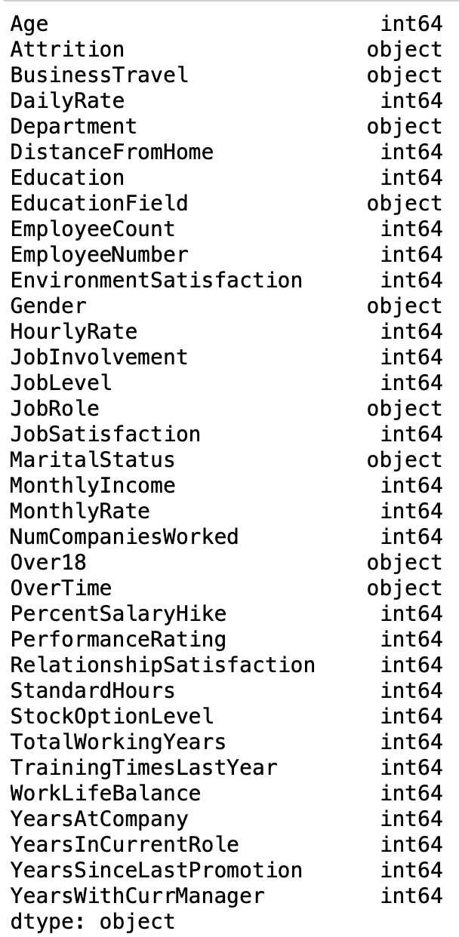
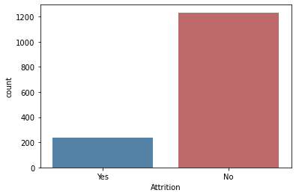
data
Notes:
I obtained my data through the Kaggle website. This data is a fictional data set created by IBM data scientists. It consists of 35 features selected by the data scientists that are various potential factors that could lead to employee attrition throughout a company. These features range from Age to Education to years with the company.
I wanted to obtain a count of the number of employee attrition by taking a closer look at the employees that stayed, which is identified by (no) vs. the number of employees that left the company (yes). I was able to visualize this count using the seaborn Python library:

Slide 6
Exploratory data analysis
Bar Chart of the Count of Employees that Stayed (below)
Pair Plot of Age and Monthly Income (left)
Notes:
The slide here represents how age and monthly income affect attrition regarding the data. To do this, I wanted to show the number of employees who left and stayed by age and examine the monthly income using 'sns.pairplot'. The data shows that the highest count of employee attrition ranges between the ages of 29 and 31, and the highest retention age is between 34 and 35.

Slide 7
Exploratory data analysis (cont)
Notes:
Here is a simple pie chart to show the distribution of educational backgrounds among the employees. To visualize this, I created a pie chart of the Education fields.

Slide 8
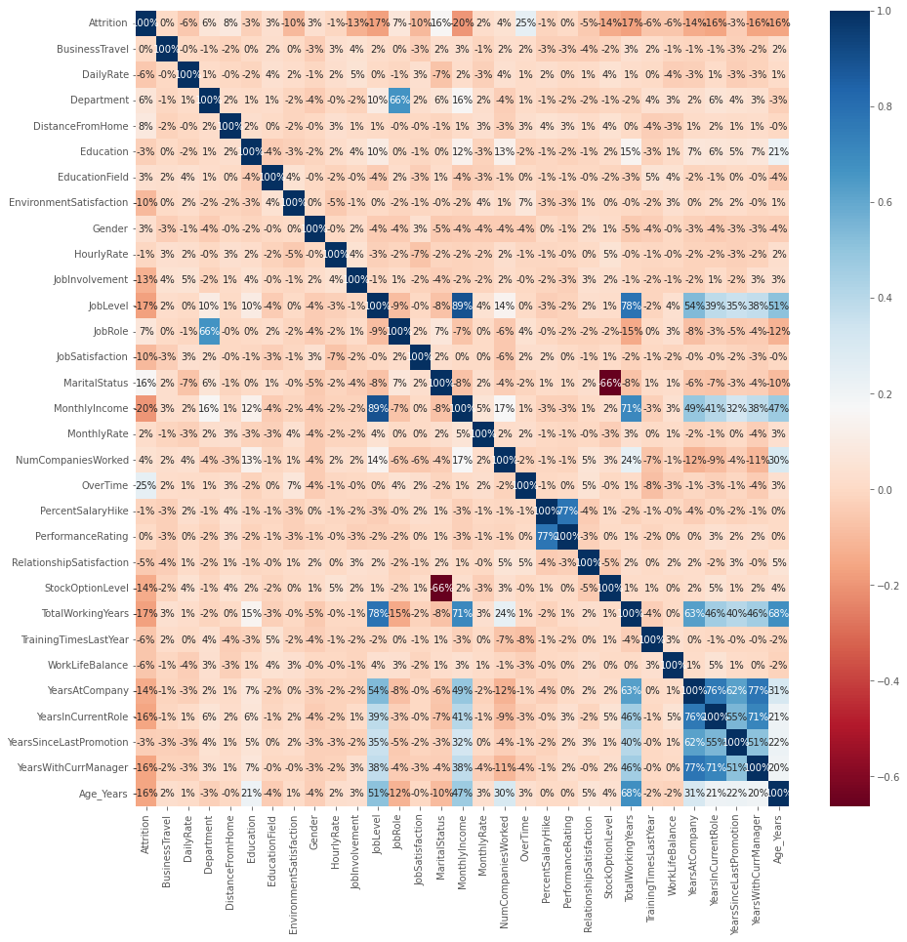
Methods and analysis
Correlation Heat Map of Features
Notes:
To start my analysis, I did a deep dive into the data by taking a look at the object data types. This lead me to delete some columns that were not needed…such as:
Over 18
StandardHours
EmployeeCount
Once the columns were removed rom the data set, I acquired the correlation of the remaining columns, which was visualized through a heatmap using the seaborn Python library.

Slide 9
Methods and analysis (cont)
Transformed non-numeric columns into numerical
Create new column to store age value
Remove the column ‘Age’ from the front of data
Make ‘Attrition’ the first column
Split Data into independent ‘X’ and dependent ‘Y’ data
Divide date into 75% Training and 25% testing
Apply Random Forest Classifier
Notes:
To prepare the data for the model, I transformed the non-numeric columns into numerical ones using the LabelEncoder from sklearn.preprocessing. I then moved on to conduct a minor data transformation to create a new column to store the age value. This transformation is only to put the age values at the end of the data set. Then remove the column 'Age' from the front of the data set so that the target column of 'Attrition' is first. To commence the modeling process, I split the data into independent 'X' and dependent 'Y' data. The data set was divided into 75% training and 25% testing. After splitting the data, I then applied the Random Forest Classifier to learn from the training data and see how accurate it was on that data.

Slide 10
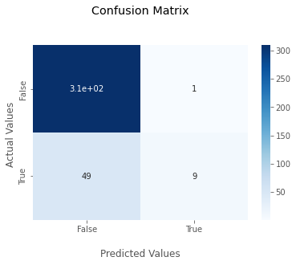
evaluations
Classification Accuracy Score: 0.9791288566243194
Confusion Matrix Score: 0.8641304347826086
Notes:
I obtained an accuracy score of 0.979 using the function forest.score. The model is about 97.91% accurate on the training data. When the confusion matrix and accuracy for the model on the test data were computed, I achieved a score of 0.8641304347826086. This test demonstrates that the model correctly identified 86.41% of the employees that eventually departed the company.

Slide 11
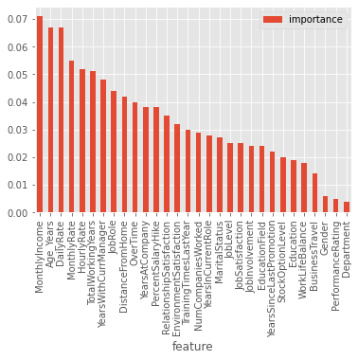
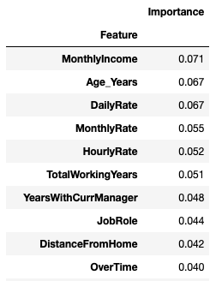
Evaluations (cont)
Feature Importance
Notes:
To see what the model perceives as the essential attrition features in the data set, I produced code that will return the feature importances. The results yielded that 'Monthly Income' had the highest importance score, followed by 'Age_Years' and that 'Business Travel' and 'Gender' were identified as the lowest importance. I generated a bar chart to visualize the feature importance in descending order.

Slide 12
Future Uses/Additional Applications
Helps companies understand which employees are at risk of departing
Aids in intervention for retaining employees
Helps HR managers understand why attrition is happening within
Can be used to adapt workforce strategy to align with company objectives
Notes:
I believe that this method is an excellent opportunity to predict employee attrition. Predicting turnover helps companies understand which employees are at risk of departing and hint at what interventions could be implemented to reduce the attrition change. With machine learning, HR managers can see not just what happened, but understand why it happened, what will happen next, and how to adapt their workforce strategy to align with company objectives. This model can help foresee vacant positions, team budget needs, what employee benefits they can improve to keep employees happy, what departments are the most and least likely to stay at a job for a long time, and more.

Slide 13
Conclusion
Attrition is a very under-discussed yet essential concept in business. A high attrition rate can negatively impact a company, primarily in three ways:
loss of institutional knowledge
drop in productivity
increase in hiring and training costs
Moreover, a high attrition rate can also signify problems with a business. While attrition happens when employees leave on any basis, including layoffs or termination, the general concern is when employees decide to leave a company. The trick with employee attrition is understanding who departs your company and why they go.
Notes:
Thank you for your time and this concludes my presentation.

Slide 14
References
BasuMallick, C. (2021, March 11). What Is Employee Attrition? Definition, Attrition Rate, Factors, and Reduction
Best Practices. Retrieved from Spiceworks:
https://www.spiceworks.com/hr/engagement-retention/articles/what-is-attrition-complete-guide/
IBM Cloud Education. (2020, December 7). Random Forest. Retrieved from IBM.com:
https://www.ibm.com/cloud/learn/random-forest
PAVANSUBHASH. (n.d.). IBM HR Analytics Employee Attrition & Performance. e Retrieved from Kaggle:
https://www.kaggle.com/datasets/pavansubhasht/ibm-hr-analytics-attrition-dataset

